Slide 1



The Modern Resume
Building Your Brand
Steve Jones
Editor, SQLServerCentral
Database Weekly
Red Gate Software
SQL Share

Slide 2
Agenda
Why Build a Brand?
Practical Tips
  Social Networking
  Volunteering
  Leadership
  Blogging
  Authoring
  Speaking
Resume Tips
Recruiters

Slide 3
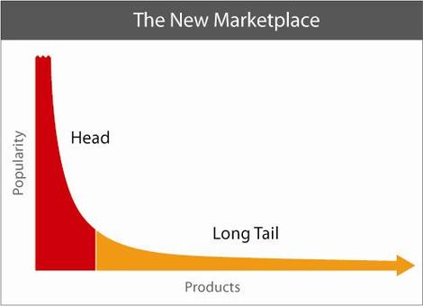



Long Tail
Desire to Hire
Potential Employees
Notes:
Has anyone read The Long Tail? Do you know what it is? There’s this idea of niches that have value. You are a niche for your next job, or you should be. You can strive to be at the head, or the tail. Nothing wrong with tail, for the head, ping me later. For the tail, you want to move up.
Next – Wheat/Chaff

Slide 4


Notes:
Know what this is? Wheat and chaff. When you harvest, you get everything, but then you need to separate things out and get the grain. Get what you want. You want to get separated for the position that is right for you, or that you want.
In other words – (Next umbrella)

Slide 5

Notes:
Stand out of the crowd.
Next – How to stand out

Slide 6

Notes:
You can be average, you can be OK. You don’t have to be a superstar. You can be like Roc, a garbage man, working every day. A pro, doing his job. Earning a living, and proud of it.

Slide 7
How to stand out?
Profiles
Volunteer
Research
Be a Leader
Blog
Publish
Speak
Can be Internal or External
Notes:
Various ways, important thing (Click) these can be external or internal to your job. External meaning out in public, internal, behind the firewall.
Next - Caution

Slide 8

Notes:
Be careful as you move forward (next CareerBuilder)

Slide 9
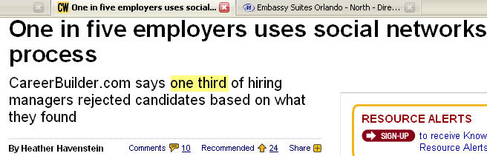
Notes:
People will look for you (next trip ups)

Slide 10

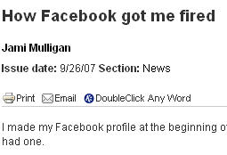
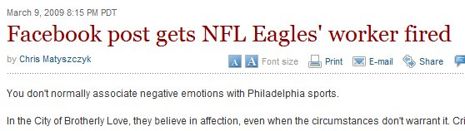
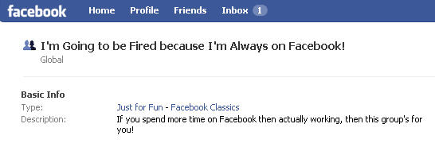
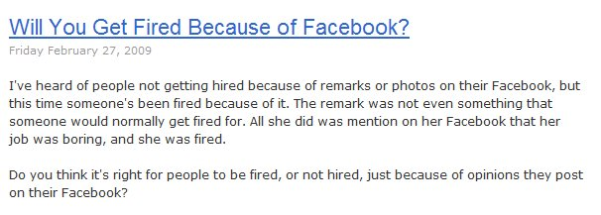
Notes:
Bad profiles
Emabaress MS, get fired (picture of Mac on loading dock)
Too much time on networking
Concept of privacy
It’s not big brother, it’s older brother.
(next Image is Everything)

Slide 11
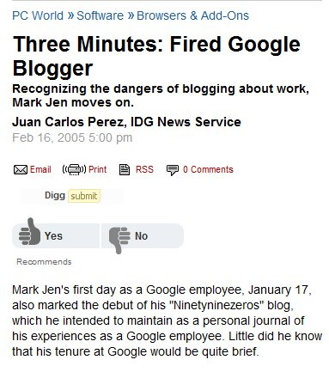


Slide 12
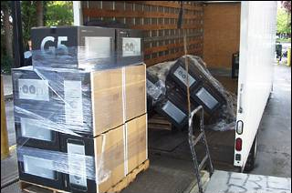

Slide 13
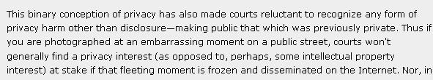
Courts won’t generally find a privacy interest

Slide 14
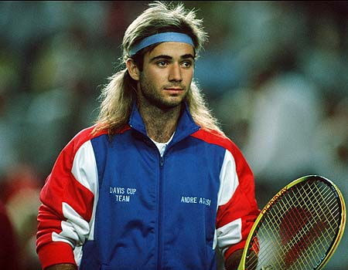
Image is Everything
Not Everything, but it does matter
Notes:
Next – online profiles

Slide 15
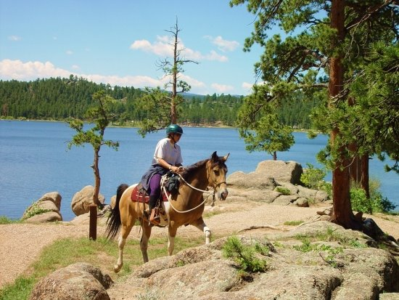

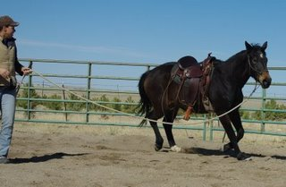

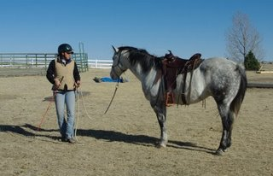

Slide 16





Social Networking
?
Notes:
Survey, count members of each
Next - Authors

Slide 17
Online Profiles
Web 2.0 / Social Networking
No different from the real world
  Chamber of commerce
  User groups
  BBB
In today’s world, the online world can take the place of these offline events.
Notes:
Building an online profile is a no different than things done in the past in the real world. Chamber of Commerce or BB meetings, user groups, other business associations, all had happy hours or other ways for people to connect with each other, get to know each other professionally, and create opportunities.
This is the modern “golf course”

Slide 18
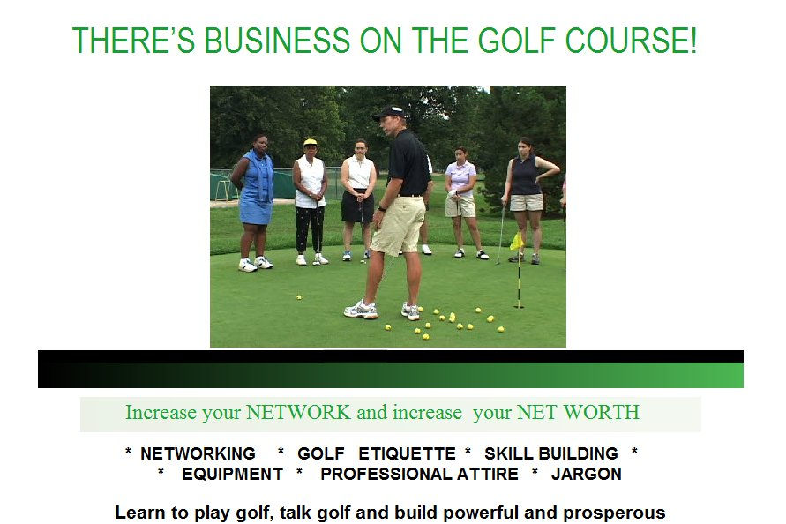
Notes:
This is the modern golf course. How many deals have puzzled you in business? How many times have you suggested that your boss chose a vendor over a game of golf, a dinner, or some other event. Business is involved with relationships between people. Social networking can help you expand those reaches.

Slide 19
Online Profiles
A way to network with other professionals
A way to let others know about you
  What you are engaged in
  Your current status
A way to hear about
  Opportunities
Notes:
Building an online profile is a no different than things done in the past in the real world. Chamber of Commerce or BB meetings, user groups, other business associations, all had happy hours or other ways for people to connect with each other, get to know each other professionally, and create opportunities.
This is the modern “golf course”

Slide 20
Online Profiles
Building an online profile
  Facebook
  LinkedIn
  Plaxo
  MySpace
  Twitter
  Blogger/Wordpad/Typepress/?
  ?
Use an email that you can monitor.
Update this on a regular basis
  Every 2-4 weeks
Get email updates on a reasonable schedule
Notes:
CareerBuilder says 22% of hiring managers search for an online profile.
You want to manage your profile. Not lie, but disclose and show yourself off. (pager story)
Anyone can create one for you. Watch for your profile online. Especially if you have had issues. Don’t create one.
Washington Post or Kids test. If you wouldn’t want them to see it, don’t put it up there.
Next - Leadership

Slide 21
Online Profiles
Give “them” one
  They’ll find one anyway
Be prepared to explain any you have created
  And maybe some you haven’t
  Example coming up
Be professional
  You can have fun, but keep it separate
  ALL your actions reflect on you, remember that.
  Use “THE Test”
Notes:
CareerBuilder says 22% of hiring managers search for an online profile.
You want to manage your profile. Not lie, but disclose and show yourself off. (pager story)
Anyone can create one for you. Watch for your profile online. Especially if you have had issues. Don’t create one.
Washington Post or Kids test. If you wouldn’t want them to see it, don’t put it up there.
Next - Leadership

Slide 22
Online Profiles
Avoid identity information
  Check with your family
Keep this profile professional
  Create a 2nd one for personal information
Google Alerts
  Track posts about you
Notes:
CareerBuilder says 22% of hiring managers search for an online profile.
You want to manage your profile. Not lie, but disclose and show yourself off. (pager story)
Anyone can create one for you. Watch for your profile online. Especially if you have had issues. Don’t create one.
Washington Post or Kids test. If you wouldn’t want them to see it, don’t put it up there.
Next - Leadership

Slide 23
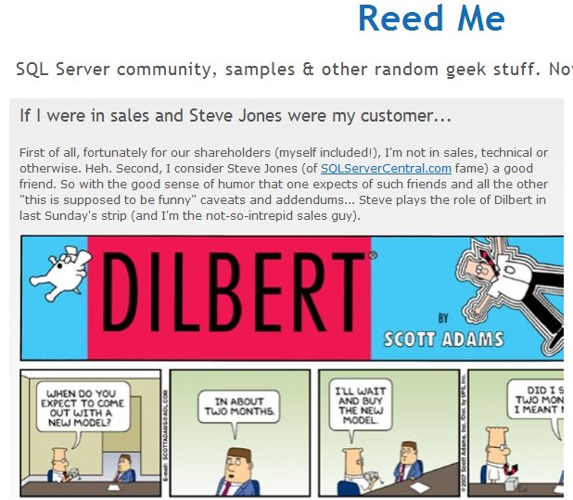

Slide 24
Volunteer
PASS/Local Group
  Be sincere
  Be sure your name is out there
  Document efforts
Work
  Tackle something that needs to be done
  Be sure this is noted somewhere, like the intranet, company newsletter, etc.

Slide 25
Volunteer
Forums
  Help others by answering questions
  Pay it forward
  Force yourself to learn more/check yourself
Build a Project (Codeplex)
Non-Profit Organizations
  Could be technical or nontechnical
Don’t volunteer unless you want to

Slide 26
Research
Ask questions your online
  Can be added to your blog
  Show some back story, thought process, some effort being made
  Shows you are learning and unafraid to ask for help.
  Shows that you know how to find help
    This can be useful in an interview
Notes:
Ask your own questions online. As you learn something, put it back out there. Give the back story, the why, the how, the what you learned, or the how it helped you.
This shows you are working on your own career and knowledge. Both to your current boss and potential future ones.
Next - Documentation

Slide 27
Leadership
Everyone needs leaders
Leader != Manager
  But it helps
You can be
  Project leader
  Organization leader
  Thought leader
This does not have to be in technology!
  Document your efforts
Notes:
Leadership helps you stand out.
This is not a manager, though it can be. And that helps.
Project leader – On some task, provide coordination, direction, ideas
Organization – Can be internal or external, formal or informal.
Thought – Just express yourself. You can be someone that people follow, or maybe counsel
Next - blogging

Slide 28
Blog Survey
Who has a technical blog?
Who reads technical blogs regularly?
10% have technical blogs
80% read blogs

Slide 29
Blogging
A chronicle
This is a your voice
Write about what you
  Learn
  Know
  Solve
  Do
  Think

Slide 30
Blogging
Don’t overthink it.
Tackle small, discrete items
Ignore similar posts
Remember this is about YOU!
A long term chronicle of your career.
Keep this blog professional
  Relate it to your career
Notes:
Examples: backups fail, trying to explain why log restores needed.
Issues with working over the phone
disconnect with developers, manager
Going to work late, after hours
Organization of files
impact to organization, what I could minimize in the future.
Building a Report
Request comes in, how you analyze the request and get more information
Structuring this report to meet needs, decisions taken
Writing queries, simple, complex, how the query translates into the business need, planning for future changes, tuning, looking at indexes
New Report
New person? How are they different. Same person, has it gotten better
Checking for similar reports, looking for reuse
New tools/features
Next - Publishing

Slide 31
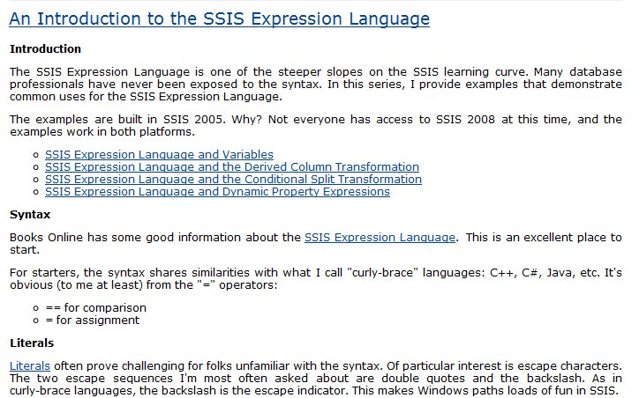
Example 1

Slide 32
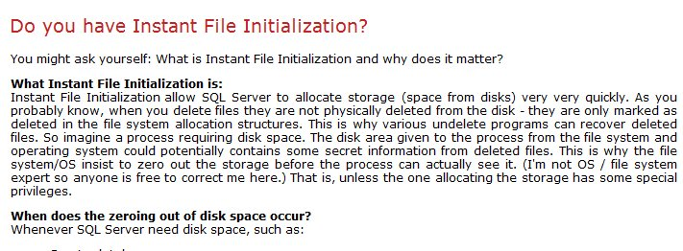
Example 2

Slide 33
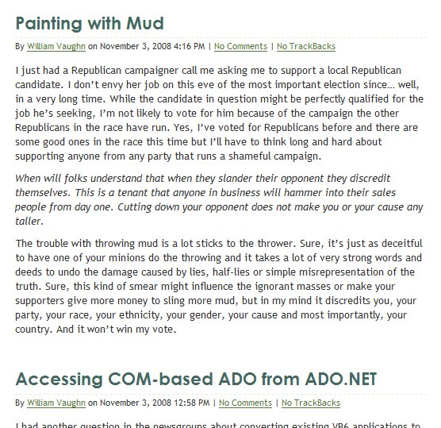
A Mistake
Politics
Development

Slide 34
How to blog
Get Permission
Be smart
  Don’t disclose financial information
  Keep company secrets secret
Be consistent
  Pipeline and schedule
  Be clear
  A survey of hiring managers showed they tend to look at 5-10 posts.
Notes:
Ask your boss, set rules, keep it simple
Don’t do anything that you wouldn’t want done to you
Get ahead of the curve and make this a regular occurrence. Choose a reasonable schedule. I’d say once every other week at a minimum, set reminders in Outlook.
If you have nothing interesting, write that. IF that happens too often, think about that as well. Time for a new job
Imagine you’re writing for a jr DBA or new guy in your position, explain things clearly. Don’t assume too much (may vary for internal blogging)
Big internal bloggers: Andy Grove – Intel,
Next – Blogging Ideas

Slide 35
How to blog
Don’t copy other posts
Don’t copy other posts
Don’t copy other posts
Do your own research
Link to others and give credit
Keep a record
  Use Blogger/Word Press/Typepad
Live Writer is great
Notes:
Ask your boss, set rules, keep it simple
Don’t do anything that you wouldn’t want done to you
Get ahead of the curve and make this a regular occurrence. Choose a reasonable schedule. I’d say once every other week at a minimum, set reminders in Outlook.
If you have nothing interesting, write that. IF that happens too often, think about that as well. Time for a new job
Imagine you’re writing for a jr or new guy in your position, explain things clearly. Don’t assume too much (may vary for internal blogging)
Big internal bloggers: Andy Grove – Intel,
Next – Blogging Ideas

Slide 36
Authoring / Publishing
Become a teacher
Think “Essay”
  Focus, focus, focus
Don’t be intimidated
Notes:
1 - Print is still good, and it’s exciting, but it’s not necessary. Big time investment, more of a “head of the tail” not “Tail of the tail” idea.
Lulu – Vanity if you really want to)
2 - As you try to write online, think of writing an essay
Focus on one thing. Don’t try to solve all issues. Don’t get carried away with setup. Andy as example
3 - If you’ve solved it, there might be 1,000 people that have, but likely 5,000 that haven’t.
Next - Volunteer

Slide 37
Authoring / Publishing
Different choices
  SQLServerCentral.com
  SQLTeam.com
  Simple-Talk.com
  SQL-Server-Performance.com
  SQL Server Magazine
.NET
  Simple Talk
  Visual Studio Magazine
Notes:
1 - Print is still good, and it’s exciting, but it’s not necessary. Big time investment, more of a “head of the tail” not “Tail of the tail” idea.
Lulu – Vanity if you really want to)
2 - As you try to write online, think of writing an essay
Focus on one thing. Don’t try to solve all issues. Don’t get carried away with setup. Andy as example
3 - If you’ve solved it, there might be 1,000 people that have, but likely 5,000 that haven’t.
Next - Volunteer

Slide 38
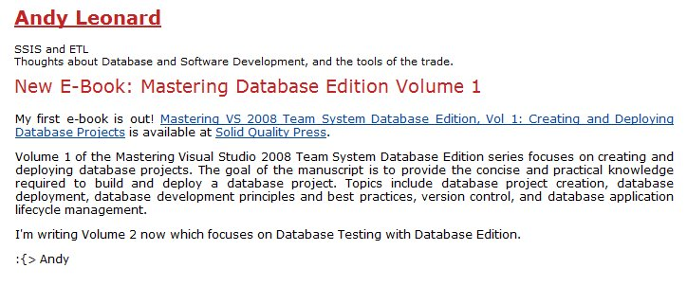
Books
Long projects
Lots of authors subcontract out
  Social networking can help you find these
Promote it

Slide 39
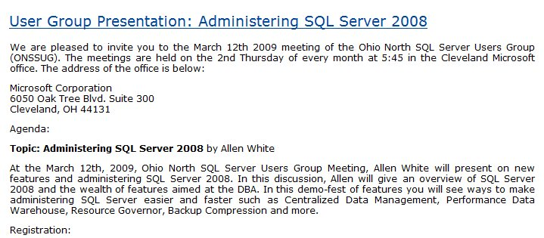
Speaking
Offline efforts
Promote it online
  Market on your blog (or others)
  Support with downloads
  Make sure there is a permanent URL

Slide 40

Documentation
Document everything.
  Never know when you’ll need something
Don’t clutter your resume
  But have links available
  Or have an online CV
Document mistakes
  Let them know you’re not that guy:
Notes:
1 – keep track of what you do. Use Gmail/Hotmail, forward your blogs. Know what you’ve done. It helps you track your data shadow. Know what you wish you hadn’t as well.
2 – Keep your resume simple. Even in this day of electronics, go with 2 pages, no more. After 2-3 jobs, summarize to 2 lines, link to other things. A CV, complete history isn’t a bad idea.
3 – Find out what is wrong in your data shadow. Know what’s out there and have a reason, admit mistakes (know what you learned) and also be sure you know where confusion lies.
Next – End

Slide 41
Resume Tips
1-2 pages (resume)
  CV may be longer
Include branding links
  To blog or promotional posts
  Create a page of your accomplishments
Be professional
  Be relevant
  Don’t be funny
    Weird Things on Resumes
Notes:
Weird things
Pig wrestling champion
Cooks Exotic meats
Good things
- gold medalist
- lead in local theater

Slide 42
Cover Letters
This is the first impression
  This is a pre-interview
Customize for each company
  How to write one?
    Google search
    Practice
  How not to write one?
    http://www.bradmcgehee.com/2010/03/how-not-to-write-a-resume-cover-letter/

Slide 43
Recruiters
A great source for you job hunt
Many jobs go through recruiters
Non-Exclusive
Make sure they have you branding information in a profile

Slide 44
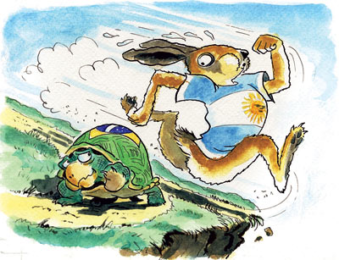
Balance
You can have a life and still do this
Work at a pace that fits your life. The key is to keep working.
Notes:
You can still have a life while you grow your brand. The key is to find some balance. Work a little less, or shift work, make this a hobby. Work at a pace you can handle. Remember this story? Who won? Steady work can build a brand.

Slide 45
Links
The Modern Resume blog – Weekly notes based on this presentation and new information.
Salary Negotiation: 32 Job Pay Tips - Focuses the job negotiation lens on the 32 salary negotiation tips for IT professionals. Includes exercises and questions to assist in preparation.
Examples of Interview Questions – Good general list of questions
The First Step is to Start – Motivational post .

Slide 46


The End
Touch your resume every quarter
If you find something that works, send me a note
Set a reminder for 6 months from today and look back
Questions?
Career Forums at www.sqlservercentral.com/forums
www.themodernresume.com

Slide 47



Brad McGehee’s
SQL Server Stumpers
"You can have an unlimited number of clustered indexes on a table."
True or False?

Slide 48


Did you know?
"SQL Compare can find differences between your source control scripts and a live database. "
Elliot Matthew Red Gate Software

Slide 49
Brad McGehee’s
SQL Server Stumpers
"You can have an unlimited number of clustered indexes on a table."
False!

Slide 50


The Exceptional DBA
Awards
"The awards will give an exceptional DBA some much-deserved recognition and help to increase the awareness of the importance of the DBA role among the IT community."
Brad McGehee Exceptional DBA Awards Judge
SPONSORED BY

Slide 51
Brad McGehee’s
SQL Server Stumpers
"If the SQL Server Browser Service is not running, you cannot connect to a named instance by name."
True or False?

Slide 52


Did you know?
"Network resilience in SQL Backup Pro lets you create robust and resilient backups by resuming backup operations that have been interrupted by network outages."
Nigel Morse Red Gate Software

Slide 53
Brad McGehee’s
SQL Server Stumpers
"If the SQL Server Browser Service is not running, you cannot connect to a named instance by name."
True!

Slide 54

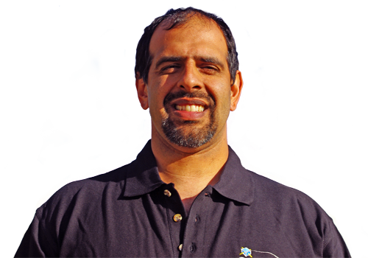
Did you know?
SQL Server Central has highly active forums, where you can get a response to a question on SQL Server and other topics in a matter of minutes.

Slide 55
Brad McGehee’s
SQL Server Stumpers
"A full database backup truncates the log when the database recovery mode is set to FULL or BULK LOGGED."
True or False?

Slide 56


Did you know?
"SQL Response sends you alerts and recommendations about the health and activity of your SQL Servers, so you can work proactively to minimize problems."
David Connell Red Gate Software

Slide 57
Brad McGehee’s
SQL Server Stumpers
"A full database backup truncates the log when the database recovery mode is set to FULL or BULK LOGGED."
False!

Slide 58


Did you know?
Simple-Talk.com has a wealth of articles written by industry experts on SQL Server, .NET and SysAdmin, with no registration required to access each article.

Slide 59
Brad McGehee’s
SQL Server Stumpers
"After updating the fragmentation of an index using ALTER INDEX REBUILD you don't need to update the statistics."
True or False?

Slide 60


Did you know?
"SQL Prompt simply sits behind the scenes and provides unobtrusive help when you press CTRL+SPACEBAR or when you type "." after a table/view/alias name. "
Simon Galbraith Red Gate Software

Slide 61
Brad McGehee’s
SQL Server Stumpers
"After updating the fragmentation of an index using ALTER INDEX REBUILD you don't need to update the statistics."
True!

Slide 62
Did you know?
"SQL Compare can find differences between your source control scripts and a live database. "
Elliot Matthew Red Gate Software

Slide 63
Brad McGehee’s
SQL Server Stumpers
"SQL Server automatically creates statistics on an index and it is impossible to turn that feature off."
True or False?

Slide 64


Did you know?
"The Outlook Add-ins for Exchange Server Archiver deliver a truly 100% transparent
end-user experience "
Chris Bacon Red Gate Software

Slide 65
Brad McGehee’s
SQL Server Stumpers
"SQL Server automatically creates statistics on an index and it is impossible to turn that feature off."
True!

Slide 66
Did you know?
"Network resilience in SQL Backup Pro lets you create robust and resilient backups by resuming backup operations that have been interrupted by network outages."
Nigel Morse Red Gate Software

Slide 67
Brad McGehee’s
SQL Server Stumpers
“Certificates can be used to only encrypt other keys (symmetric or asymmetric).
True or False?

Slide 68


Did you know?
"ANTS Performance Profiler shows you line-level code timings, so you can drill down to the specific lines of code responsible for performance inefficiencies. "
Bart Read Red Gate Software

Slide 69
Brad McGehee’s
SQL Server Stumpers
“Certificates can be used to encrypt data or other keys."
False!

Slide 70
Did you know?
SQL Server Central has highly active forums, where you can get a response to a question on SQL Server and other topics in a matter of minutes.

Slide 71
Brad McGehee’s
SQL Server Stumpers
“In SQL Server 2008, you can mirror a database set to compatibility mode 90.”
True or False?

Slide 72
The Exceptional DBA
Awards
"The awards will give an exceptional DBA some much-deserved recognition and help to increase the awareness of the importance of the DBA role among the IT community."
Brad McGehee Exceptional DBA Awards Judge
SPONSORED BY

Slide 73
Brad McGehee’s
SQL Server Stumpers
“Database Mirroring does not check the compatibility mode. It will mirror a database at any level."
True!

Slide 74
Did you know?
Simple-Talk.com has a wealth of articles written by industry experts on SQL Server, .NET and SysAdmin, with no registration required to access each article.

Slide 75
Brad McGehee’s
SQL Server Stumpers
“All page types can be restored with the single page restore option.”
True or False?

Slide 76
Did you know?
"SQL Compare can find differences between your source control scripts and a live database. "
Elliot Matthew Red Gate Software

Slide 77
Brad McGehee’s
SQL Server Stumpers
“While data pages can be restored with the single page restore feature, the file header pages, boot page, GAM, SGAM, Diff map and ML maps cannot be restored."
False!

Slide 78
The Exceptional DBA
Awards
"The awards will give an exceptional DBA some much-deserved recognition and help to increase the awareness of the importance of the DBA role among the IT community."
Brad McGehee Exceptional DBA Awards Judge
SPONSORED BY

Slide 79
Brad McGehee’s
SQL Server Stumpers
“SELECT 6 | 7 returns 7.”
True or False?

Slide 80
Did you know?
"ANTS Performance Profiler shows you line-level code timings, so you can drill down to the specific lines of code responsible for performance inefficiencies. "
Bart Read Red Gate Software

Slide 81
Brad McGehee’s
SQL Server Stumpers
“SELECT 6 | 7 is an inclusive OR operation, which will return 7.
6 = 0110
7 = 0111
The OR result is 0111.”
"
True!

Slide 82
The Exceptional DBA
Awards
"The awards will give an exceptional DBA some much-deserved recognition and help to increase the awareness of the importance of the DBA role among the IT community."
Brad McGehee Exceptional DBA Awards Judge
SPONSORED BY

