Slide 1


Basic SQL Server
Steve Jones
SQLServerCentral
Red Gate Software

Slide 2
Who’s here?
Developers
New/Accidental/Jr DBAs
Experienced DBAs
Managers/Project Managers
Others?
Notes:
Who’s here? A quick survey of who’s here.

Slide 3
Agenda
What is SQL Server?
Tables, etc.
Querying, or asking questions of the server
The index turbocharger
Watching your back (-ups)
Safe SQL (being secure)
That BI Stuff
Notes:
Basic Agenda. We will go fast to get through things in an hour, but please ask questions if you have them.

Slide 4
What is SQL Server?
Database
Relational database
Platform
Notes:
SQL Server is all of these things, a database, and a specific type of database called a relational database, but also a platform.

Slide 5
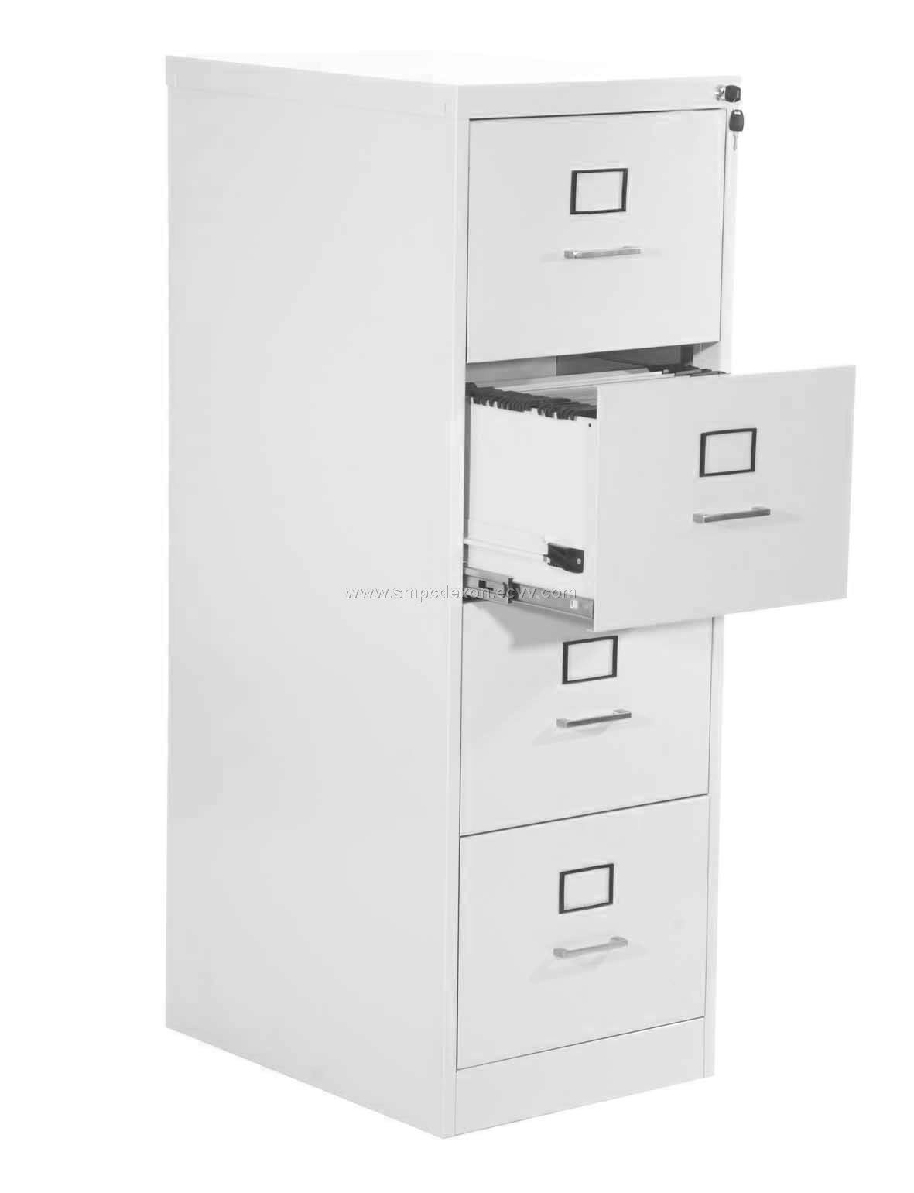
Notes:
What’s a database? Is it a simple store like this?

Slide 6

Notes:
Most people think of a database more like a library, a modern library holding different types of information (books, video, audio, images), and in different formats.

Slide 7
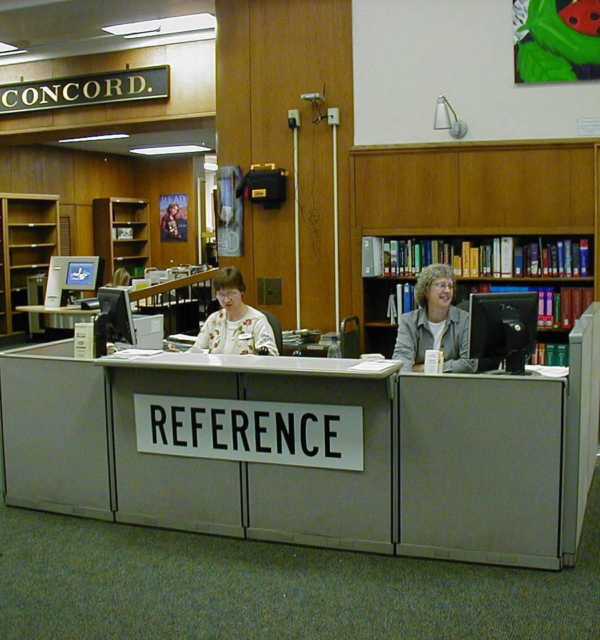
Notes:
It’s more like a reference desk. You ask for information, or help with something, and the worker (in this case the SQL Server), provides the answer. However just like in the real world, if you ask incorrectly, you get the wrong answer.

Slide 8
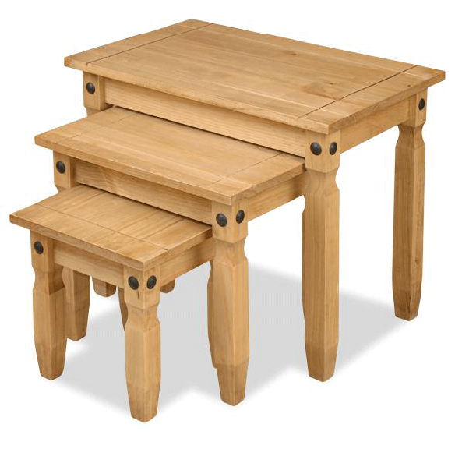
Notes:
Inside of SQL Server we have tables. We store data in these tables

Slide 9
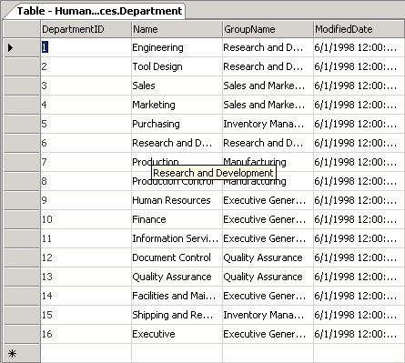
Notes:
Here’s a table. It’s a lot like an Excel spreadsheet, with rows and columns. The difference in SQL is that we define the number of columns, and their type. Rows have no meaning for SQL Server.

Slide 10
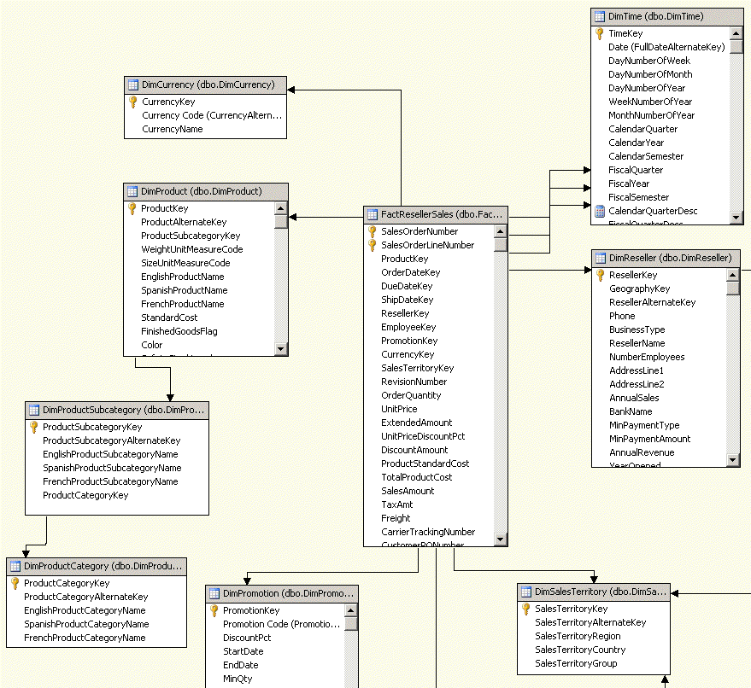
Notes:
Typically we show tables like this. This is an Entity Relationship or ER diagram.

Slide 11
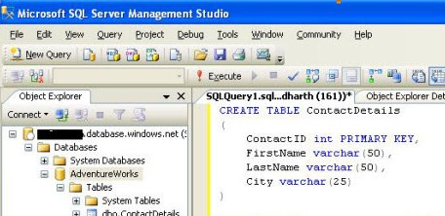
DDL
Notes:
Or more like this. (Click), this is the actual code that creates a table, whether you do it in SSMS or here by typing this manually.

Slide 12
ACID
SQL Server adheres to the ACID properties:
  Atomic
  Consistent
  Intact
  Durable
Notes:
SQL Server adheres to what are called the ACID properties. These are like the post office, they ensure that the data you store is not only safe, secure, and there, but that modifications can’t occur twice, that they are properly written down, etc. The classic example is of a bank transfer. If I deposit money, I want to be sure that my money is correctly received, AND that my account is debited. We don’t want one part of a transaction without the other. Same for withdrawals. We also want to be sure that one a change is made, it is durable, and lasting. It can’t be undone, or even partially undone.

Slide 13
How Does SQL Server Do This?
Notes:
The server keeps your data in two ways. It has data file(s) in which your data is actually stored, and a log file, in which all changes are recorded. This two phase process ensures that all changes are correctly recorded. The change is written to the log file (taking up space). Once this is done, it is written to the data file. In this way, if power is lost somewhere or there is an issue, when SQL Server starts up, it can read the log file and compare it with the data file to ensure that completed transactions were written and incomplete ones are undone.

Slide 14
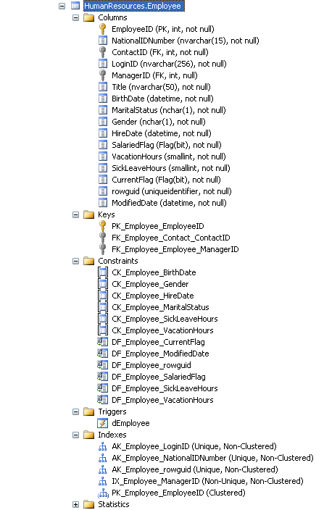
Notes:
Here is a table in SSMS, and in addition to all it’s columns, it has other items as well. Keys, constaints, triggers, indexes and statistics.

Slide 15
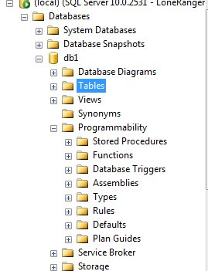
Notes:
This is Management Studio, a clip of it and you can see we have other items, or “objects” in SQL Server. We store data in these tables, but what about these other objects? Let’s talk about them.

Slide 16

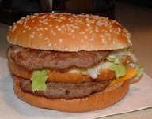
Views
A Window that looks at a table(s)
Notes:
A view is a window. It’s another way of looking at the same information. As an example, we often see things like this on TV. In reality, it’s the same thing we get in the restaurant, but it doesn’t look as nice. A view is similar. It’s a window into a table, or a series of tables that we have put together. We use a query, a set of code to determine if we are seeing a whole table, a partial table, a few columns, some rows, a conglomeration of multiple tables, etc.

Slide 17
Stored Procedures
Functions, Triggers, Assemblies
All are similar to a Procedure or Module in other development areas.
Some are T-SQL, some .NET
All are ways to provide modular programming
Notes:
We also have a number of programmable objects, where we write code, just like we might in some other applications. We have functions, triggers, assemblies (using .NET code), and stored procedures. In some of these items we use the T-SQL language inside SQL Server, some are written in .NET languages, compiled, and then linked as T-SQL objects. All of these objects exist to provide a way to develop some programming capabilities inside of SQL Server.

Slide 18
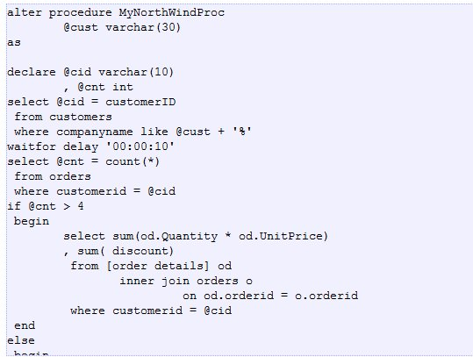
Sample Code
From www.sqlservercentral.com
Notes:
Here’s a sample stored procedure. As you can see we have a series of statements, variables, a loop, and other programming constructs.

Slide 19
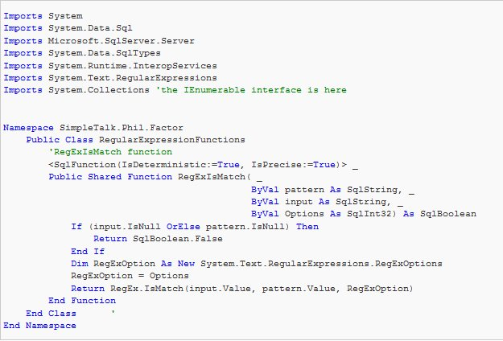
Notes:
This differs from other code, like VB.NET code as shown here. This can still be used in SQL Server as part of the SQL CLR.

Slide 20
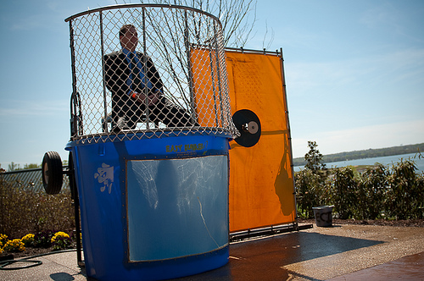
Triggers
Notes:
Triggers are a type of programming construct, but one that functions a little differently. These are sets of code that respond to certain triggers. When some event happens, which can be a query in SQL Sever, creating a new object, adding a user, or almost anything else, this code is run and can act on the data, providing auditing, or do most anything you can think of.

Slide 21
Triggers
They always fire.
ALWAYS
Types
  INSERT
  UPDATE
  DELETE
  INSTEAD OF
  DDL
Notes:
There are different types of triggers, but the basic thing to keep in mind is that they always fire in response to some action. If you have a trigger that sends an email whenever data is updated in a table, you’ll get an email EVERY TIME data is deleted. That can be a problem, and so you want to be very careful about using triggers in your applications.

Slide 22

Keys
Notes:
Not keys like this, but instead these are keys that identify data. We have two types, primary and foreign

Slide 23

Primary Keys
Uniquely Identify
George
George
George
George
George II
George III
George IV
George V
Notes:
Uniquely identify things. Rows really. But what does that mean? (click) know this family. George Foreman. Anyone know what his sons’ names are? They are all George. However that doesn’t allow unique identity them. Really their names are primary keys in this case (Click)

Slide 24
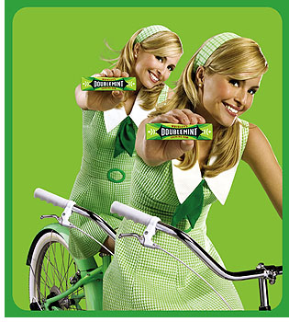
Primary Keys
In the real world, we can just tell things apart
Notes:
In the real world, we can ususally just tell things are different. We know it’s our car, or that one company is different from another, or that this person is not the same as that one. Or can we? Who’s Joan and who’s Jayne?

Slide 25
Primary Keys
In SQL Server, each table should have a primary key.
Can be one column or multiple ones
Shorter is better
Implemented by a unique index
Notes:
In the database world, or at least in relational databases, we have primary keys that are designated to tell one set of data from another, or one row from another. Here are a few facts about primary keys in SQL Server.

Slide 26
CREATE TABLE [dbo].[Developers](
[EmployeeID] [int] NOT NULL,
[Firstname] [varchar](20) NULL,
[Lastname] [varchar](20) NULL,
[Title] [char](20) NULL,
CONSTRAINT [PK_Developers] PRIMARY KEY CLUSTERED
(
[EmployeeID] ASC
)
Notes:
We can define a PK in code

Slide 27
ALTER TABLE dbo.Developers ADD CONSTRAINT
PK_Developers PRIMARY KEY CLUSTERED
(
EmployeeID
) ON [PRIMARY]
GO
Notes:
Or later by changing or ALTERing the table

Slide 28
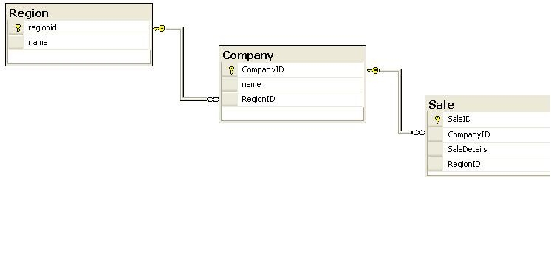
Foreign Keys
A Foreign Key is linked to a PK in another table.
1 – East
2 – West
3 – North
4 - South
1 – Acme - 1
2 – IBM - 3
1000 – 2 – 1/1/2010 - 3
Notes:
FKs are linked to other tables. Here we can see that there is a PK on each table, and it’s lnked to another table. As you can see, we have a table of Regions, things like E, W, N, S. We also then have a company table, each one linked to a region. So for a company like Acme, we have it listed in the East region. (click) for IBM, it’s in the North region. That linkage is in the Foreign Key. For a particular sale to IBM, we can see it’s linked to IBM through a key, and also linked to the North region.

Slide 29
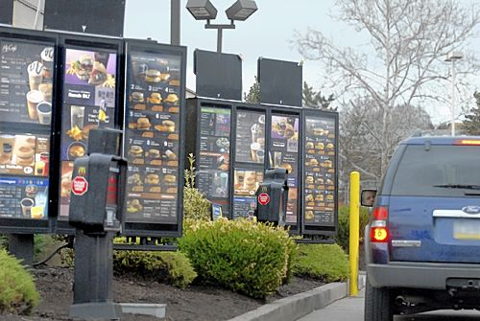
Queries
Asking for what you want
Notes:
A query is how we access data in our SQL Server database. SQL stands for Structured Query Language, and just like we might do at McDonalds, we need to know how to frame our query so that we can get the response we want. Imagine if you drove up and asked for meat, bread, and ketchup. Would you get what you wanted?

Slide 30
Queries
We use Transact-SQL (T-SQL)
Basically 4 Operations
  SELECT
  INSERT
  UPDATE
  DELETE
Notes:
We use T-SQL here. It can be simple or complex, but it primarily consists of one of these 4 operations: select, insert, update delete. Select returns information. Insert adds new information, updates changes existing information, and delete removes information from a table.

Slide 31

Queries
simple
Notes:
We use T-SQL here. It can be simple like getting these 4 columns, EmployeeID, FirstName, LastName, Title from the Developers table. This query returns all the rows in that table.

Slide 32
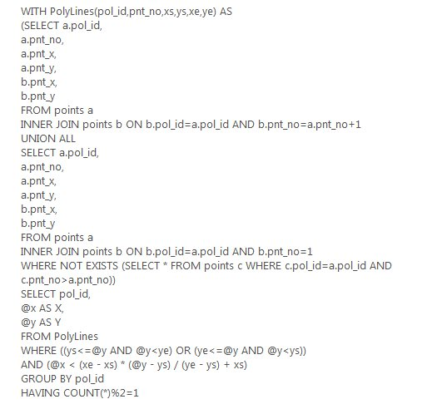
Notes:
Or complex. Here we see a query that uses a CTE, and gets data from multiple tables, linked together and then filtered. It is also grouped together.

Slide 33
Queries
Basic Parts of a Query
  Operation (SELECT/UPDATE/INSERT/DELETE)
  FROM clause (from where to get/put data)
  WHERE clause (qualify the request)
  ORDER BY clause (ordering)
Notes:
The language for making queries has filtered down to many groups, and often we have some tools, like Query Builders that people use to generate SQL. If you write code, you ought to learn these basic parts of a query. IF you just use information, hopefully you have tools to make this easier. The basic parts of a query are the operation (select, i/u/d), the FROM, the WHERE, and the ORDER. There are more advanced tools, and you can view some of the references in these slides if you need help.

Slide 34

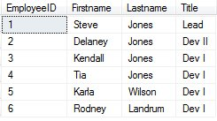
Sample Query
Notes:
To show a sample query, here we have a SELECT operation, that (click) gets data FROM the developers table.

Slide 35

Sample Query
Notes:
Here another query, but this time I’ve added a WHERE clause. What does this do? (click) You can see that it filters the developers down and returns only the shaded rows.

Slide 36

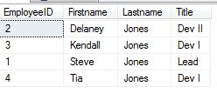
Sample Query
Notes:
Here another query, but this time I’ve added an ORDER BY clause. What does this do? (click). We now get these rows, in this particular order. The ordering tends to work in alphabetical order fby default, but you can configure the ordering on your instance to work differently. If you have a foreign language, those rules should be applied if you have configured your server, table, or query to use them.

Slide 37

Indexes
Notes:
We use indexes for speed. But what are indexes?

Slide 38
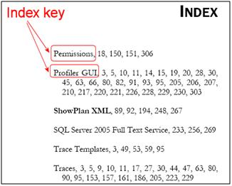
Notes:
An index is just like an index in a book. It allows you to find things quickly.

Slide 39
Indexing
Two Types of Indexes*
Clustered
  The index is the data
Nonclustered
  Index points to the clustered index
  * I am ignoring XML and spatial indexes and a few other types. There are 8 in total for specialized situations
Notes:
In SQL Server we have two types of indexes. There are clustered indexes and nonclustered indexes. I’m ignoring the more specialized types of indexes

Slide 40
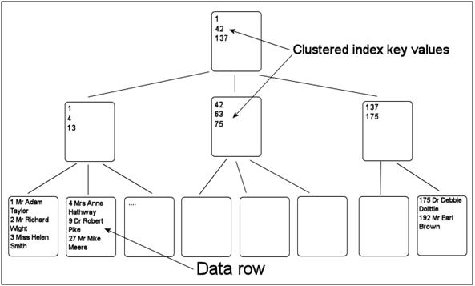
Clustered Index
Notes:
Here we have a basic diagram of what a clustered index is. The actual data is stored in what’s called the leaf of the index. Think of this as an inverted tree. If you know about tree structures in computer programming, this makes sense, but it essentially provides a way to locate the various entries in an index quickly.

Slide 41
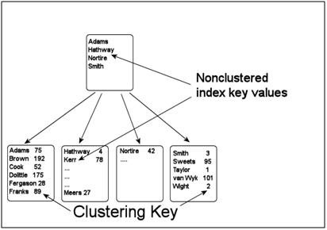
Non-Clustered Index
Notes:
Here we have a nonclustered index. The data is ordered (from the index key), but the rest of the data for the table is atually stored in the clustered index.

Slide 42
Indexing
You need them. Don’t ignore this
Don’t index every column
Create 1-2 per table to start with
Use the columns that are written in the WHERE clauses of your queries most often or are in the ON part of a join.
Notes:
Why use indexes? SQL Server is optimized to expect an index. You do not need a clustered index (a heap), but it’s better if you have one. In terms of how many, don’t index every column. Updates/inserts/deletes need to maintain these indexes, so you are creating work for the server. Create a few per table, and add more as you need them, or you find queries are running slow. Hint, if you see lots of table scans, you might be missing indexes, and there is even a table that SQL Server keeps of potential missing indexes. You should tend to index the columns used in WHERE clauses, or in the ON clause of a join.

Slide 43
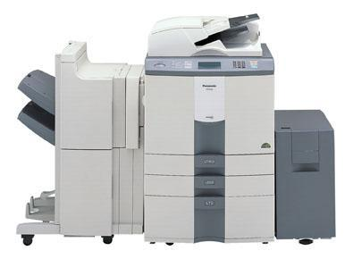
Backups
Notes:
Backups. What’s a backup? Essentially it’s a copy of your database.

Slide 44
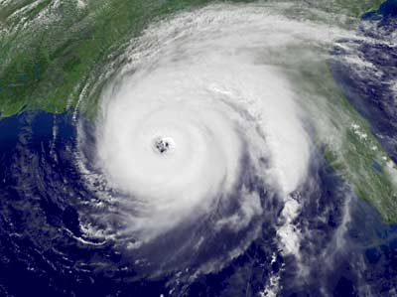
Why Backup?
Notes:
Why backup? (click) Because of disasters. We could have big one, like a hurricane.

Slide 45
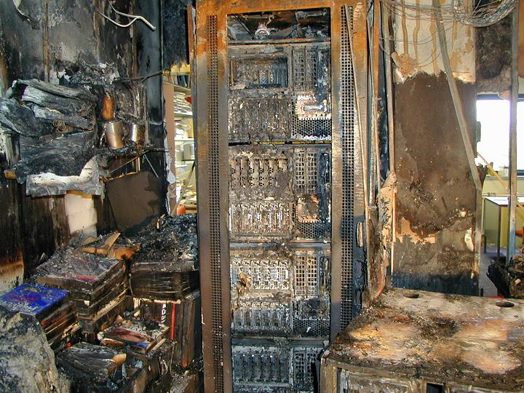
Notes:
We could have some type of fire or smaller scale disaster

Slide 46

Notes:
We could even have some accident take place.

Slide 47
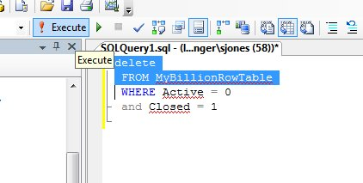
Notes:
Or even the “whoops” type of accident. How many DBAs have done this?

Slide 48
What do we back up?
Three types of backups
  Full
  Differential
  Log
The one to use depends on many things
Full Backup DOES NOT clear the log
Notes:
There are 3 types of backups: full, differential, and log. You tend to use Full and log backups for most systems, and differential if you have space/time constraints. The combination depends on your risk factors and systems. One very important thing that most people new to SQL Server don’t understand is that a full backup does not clear your transaction log.

Slide 49
Typical Backup
Full Backup every night at 1:00am
Differential Backup halfway between Full backups (perhaps 1:oopm)
Log Backups every 15 minutes
Notes:
Here is a typical backup scheme that I’ve used. This tends to provide me with no more than 15 minutes of lost data. I could lose more work time since it could take time to actual get my system running again, but this provides me with a good set of protection against many disasters.

Slide 50
Backup Notes
Make backups locally, copy remotely
Ensure you can restore
  TEST, TEST, TEST!
By default you need Full and log backups.
Get backups offsite

Slide 51

Security
Notes:
Lets’ talk about SQL Server security

Slide 52
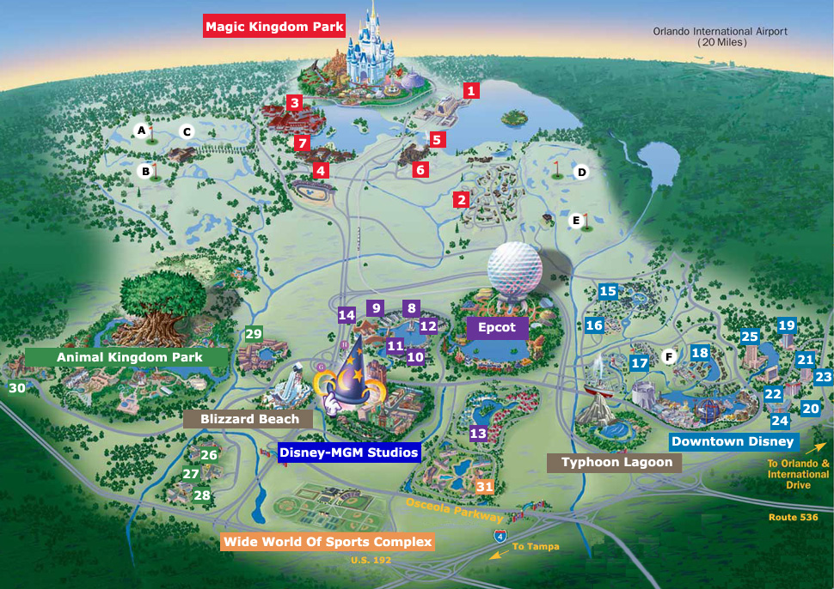
Notes:
This is the model I came up with and let me know if it makes sense. Who’s been to Disney? Think about how security, or checks work there.

Slide 53
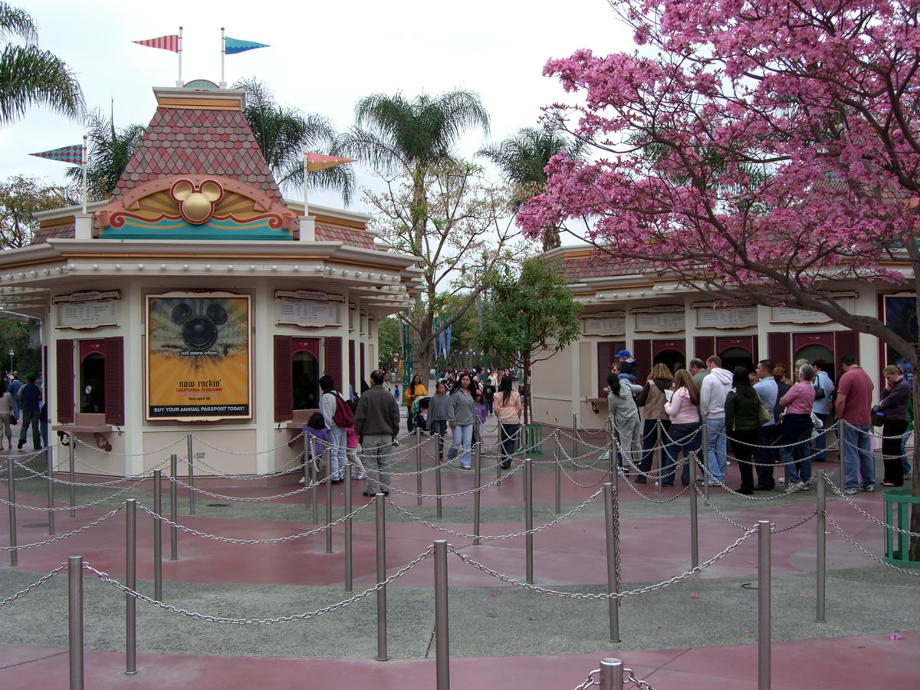
Notes:
If you go, you have a gate to get through. In this case there’s security and admissions to get through. A little money is the way you get permission.

Slide 54
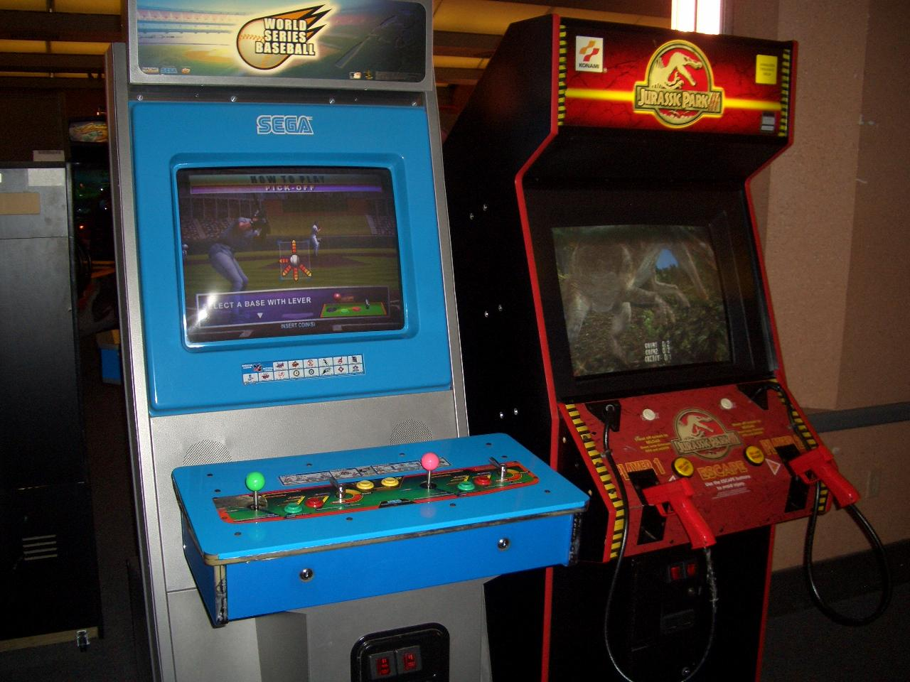
Notes:
If you go to an arcade, or some of the other games inside, you might incur another check. Again for money.

Slide 55
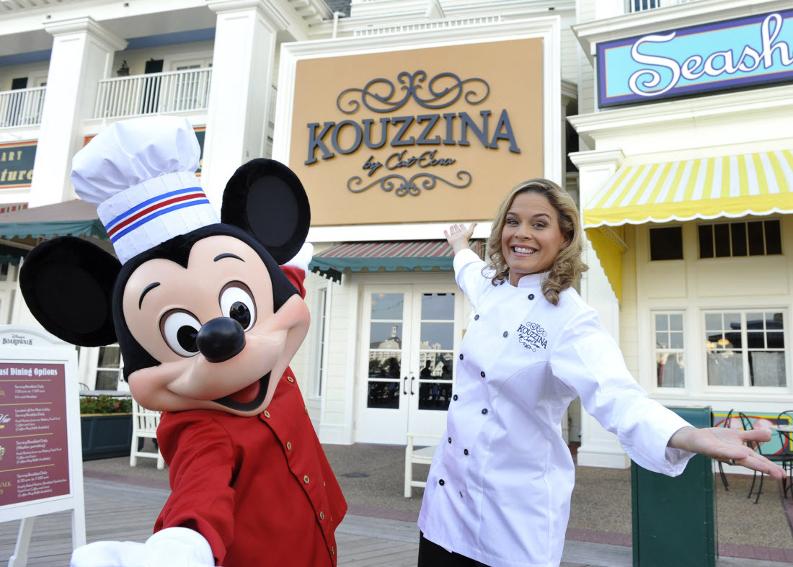
Notes:
If you want to eat, you’ll need to pay, another type of check.

Slide 56

Notes:
And if you go to Epcot Center…

Slide 57
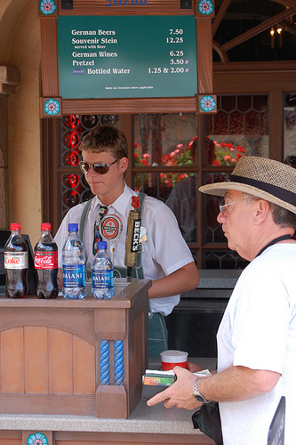
Notes:
You might have one more check. More than just with money.

Slide 58

Schema
Schema
Table
Table
Database
SQL Server Instance
Notes:
There are these multiple layers of security in SQL Server. We have your server instance, then a database(s) inside. In each database there are schemas, and inside schemas there are your tables.

Slide 59
Schema
Table
Windows
Authentication
Database
Login:
Person has access to the instance
Server level functions
*This can be a Windows group.
SQL Server Instance
Notes:
SQL Server has two types of server authentication, one of which is Windows. That uses your Windows login for your domain to determine if you have access to the server instance.

Slide 60
Schema
Table
SQL
Authentication
(supply login name/ password
Database
Login:
User has access to the instance
Server level functions
SQL Server Instance
Notes:
For SQL authentication, you need to provide a username or password. In either case, you get access to the server, which for most people doesn’t allow you to do much.

Slide 61
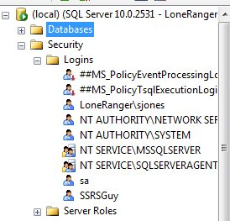
Notes:
Here you can see logins in SSMS. LoneRanger\sjones is a Windows login. “sa” and “SSRSGuy” are SQL logins.

Slide 62
Schema
Schema
Table
Table
Mapped to a User:
Steve
Login: Steve
(either Windows or
SQL authenticated)
Database
SQL Server Instance
Notes:
Once you access the server, your login is mapped to a user in order to access a database. Here we have login “Steve” mapped to the user “Steve” in a database. Usually you keep the name the same in order to make administration easy, but they can be different.

Slide 63
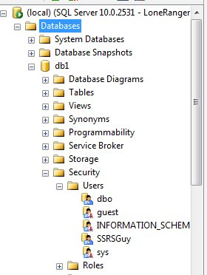
Notes:
Here we see a few users in the database “db1”

Slide 64
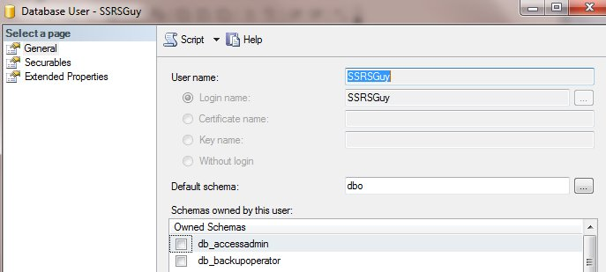
Notes:
And in the properties for a user, you can see the login it is mapped to.

Slide 65
Schema
Table
Schema
View
Table
Stored
Procedure
User: Steve
Database
SQL Server Instance
Notes:
There are these multiple layers of security.

Slide 66
Schema
Table
Schema
View
Table
Stored
Procedure
Role: Sales
Database
SQL Server Instance
Notes:
There are these multiple layers of security.

Slide 67
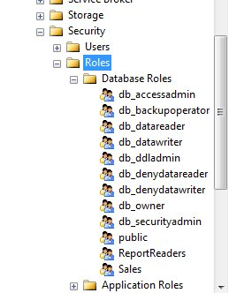

Slide 68
Login
Maps to
User (db1)
Member of
User (db2)
Role
Permissions
Permissions
Objects
Tables
Views
Stored Procedures
Functions
Schema
Contains

Slide 69
General Security Rules
Don’t use sa (or sysadmin)
Grant rights to objects
Use Roles/Schemas to group permissions
Give only permissions needed (least privilege rule)
Do not use Public role for permissions

Slide 70
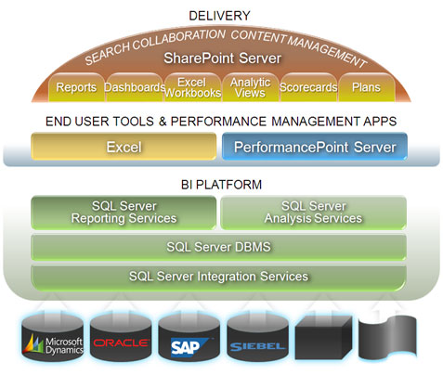
That BI Stuff

Slide 71
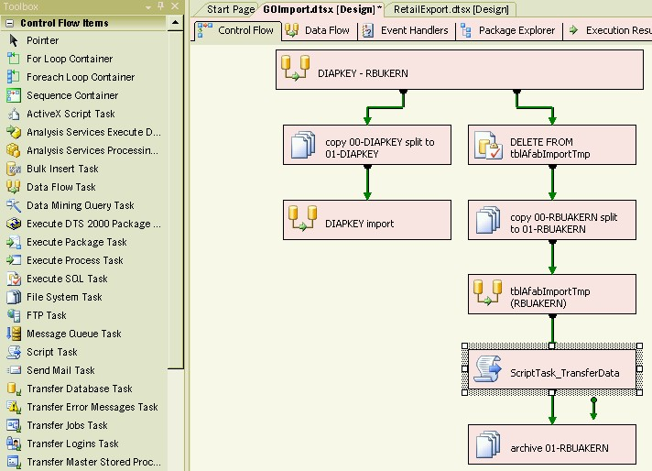
SSIS

Slide 72
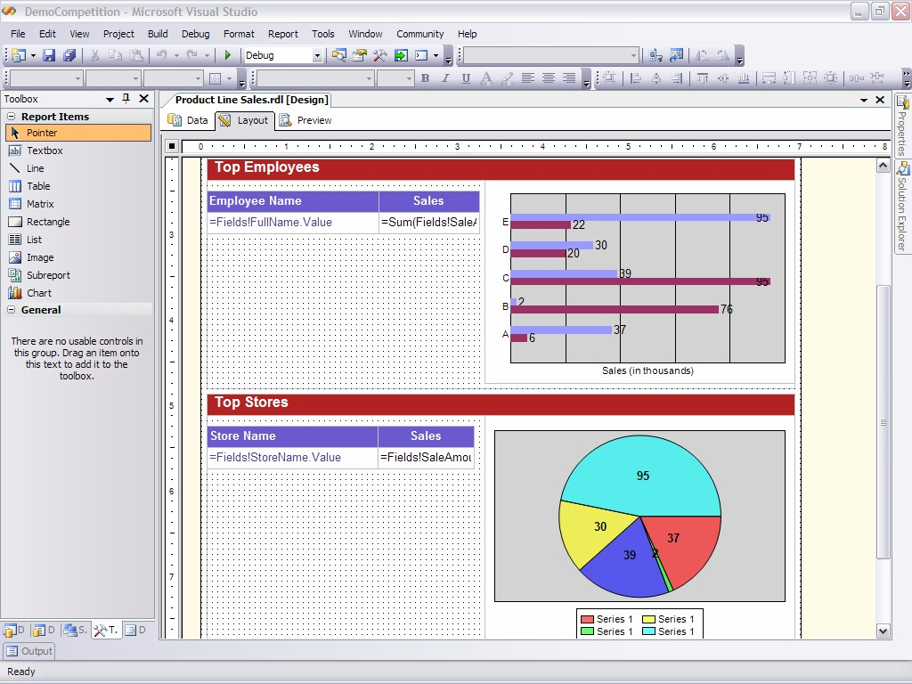
Reporting Services (SSRS)

Slide 73
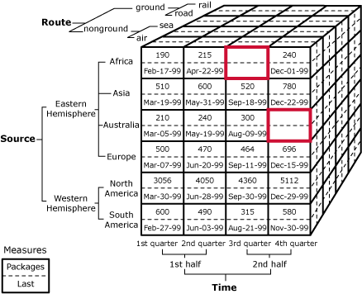
Analysis Services (SSAS)

Slide 74
SQL Server Is Huge
It’s a wide platform.
More that I haven’t covered
Books Online is a great starting point.
SQLServerCentral has daily information
Keep learning

Slide 75
The End
Questions?
References at the end
www.sqlservercentral.com/forums
Steve Jones – SQLServerCentral
www.sqlservercentral.com

Slide 76
References
General
  www.sqlservercentral.com
  www.microsoft.com/sql
  Http://msdn.microsoft.com/en-us/sqlserver/default.aspx
Books Online (BOL)
  http://msdn.microsoft.com/en-us/library/bb545450.aspx
Learning Resources
  http://www.mssqltips.com/
  http://www.simple-talk.com

Slide 77
References
Query Basics
  SQL Joins
  Joins Clarified
  Modifying Data - SQL School Video
  TSQL LAB 2 - Writing Conditional WHERE Clauses
  When To Use the Order By Clause
Creating CLR Functions
Introduction to Stored Procedures
Creating Stored Procedures - SQL School Video

Slide 78
References
Indexing
  Introduction to Indexes
  Introduction to Indexes: Part 2 – The clustered index
  Introduction to Indexes: Part 3 – The nonclustered index

Slide 79
References
Backups
  Implementing a Flexible Backup Strategy
  Every DBA Should Know Which Databases are be Backed Up
  Differential Backup Tricks
  Building Automated Backups
  Managing Transaction Logs Managing Transaction Logs
  SSAS Database Backup

Slide 80
References
Security
  SQL Server Security: Why Security Is Important
  Managing Security
  SQL Server Security Part 1
  SQL Server Security Part 3
  10 Steps to Securing your SQL Server
  SQL Server Security: Server Roles
  SQL Server Security: Fixed Database Roles

